Slide 1

Deep Learning Crash Course
Hui Xue
Fall 2021
www.deeplearningcrashcourse.org

Slide 2
Outline
Optimization cont.
Learn rate scheduler
Hyper-parameter searching
Set up the training

Slide 3

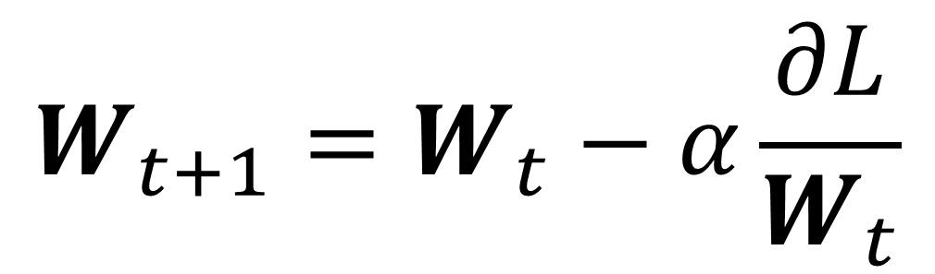
Gradient descent
$$W_{t+1}=W_{t}−α\frac{∂L}{W_{t}}$$
https://www.quora.com/Whats-the-difference-between-gradient-descent-and-stochastic-gradient-descent

Slide 4
Gradient descent
GD is vulnerable to bad conditioning of loss function (ratio of the largest and smallest eigenvalues of Hessian matrix)
Loss function changes quickly along one dimension than another dimension.
smaller gradient
Larger gradient

Slide 5
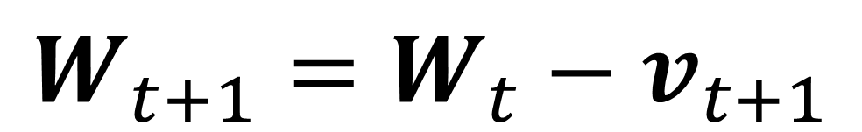
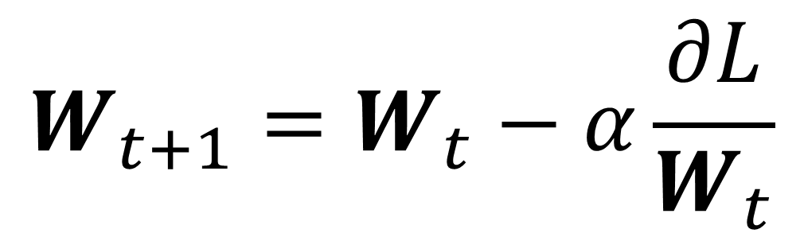
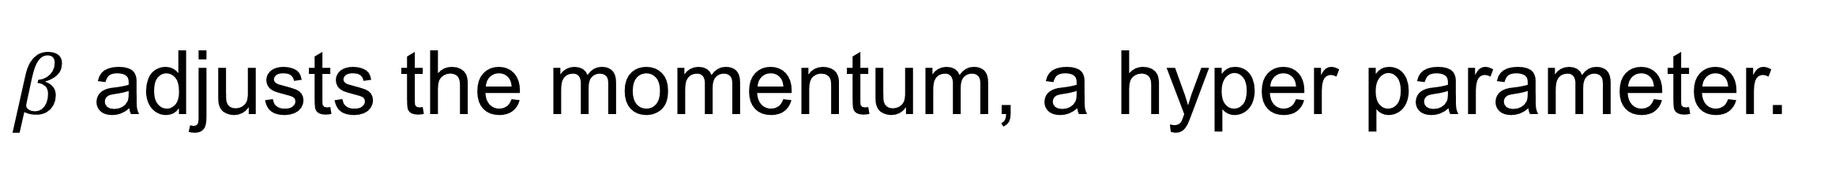
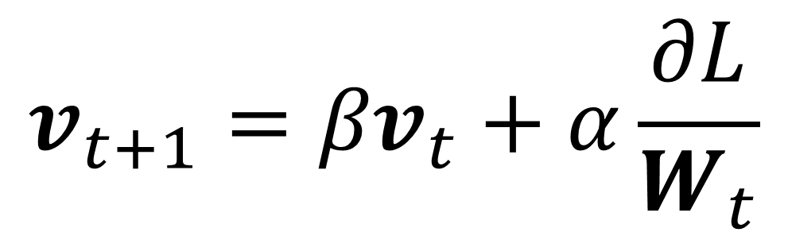
Gradient descent with momentum
IDEA: If gradient along one direction is consistent, build up more momentum to move faster long that direction
$$W_{t+1}=W_{t}−α\frac{∂L}{W_{t}}$$
GD
smaller gradient with consistent direction
$$v_{t+1}={βv}_{t}+α\frac{∂L}{W_{t}}$$
$$W_{t+1}=W_{t}−v_{t+1}$$
GD with momentum
Larger gradient
Changing directions
$β$ adjusts the momentum, a hyper parameter.
Sutskever et al, “On the importance of initialization and momentum in deep learning”, ICML 2013

Slide 6
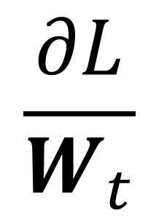
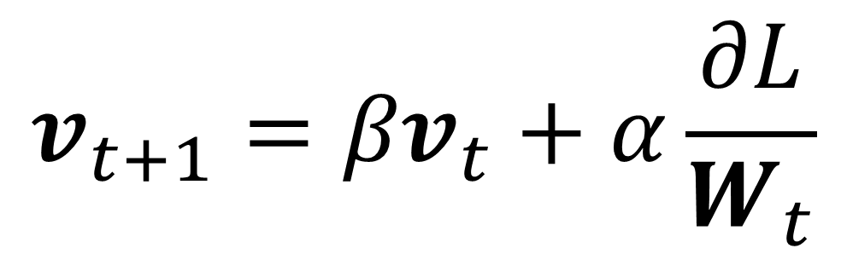
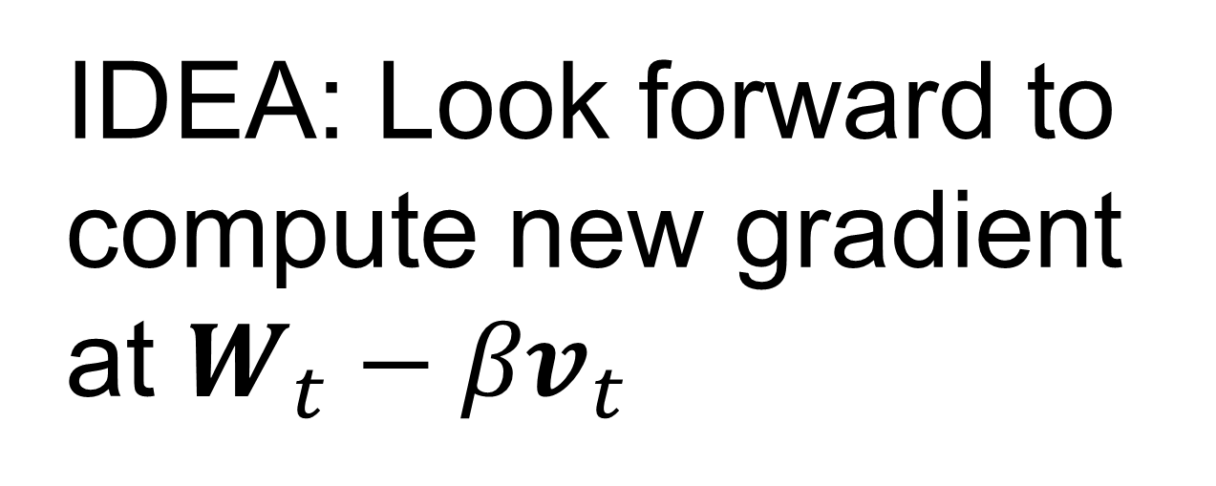
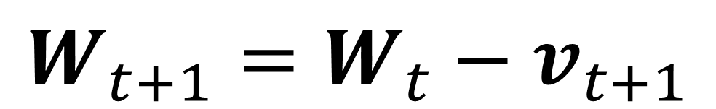
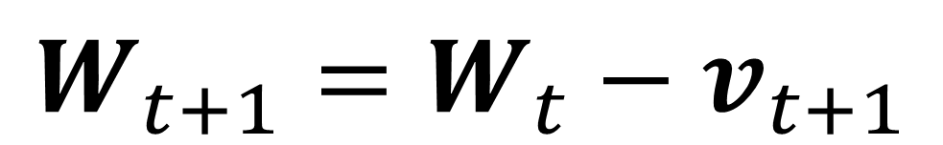
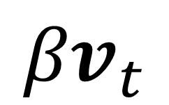
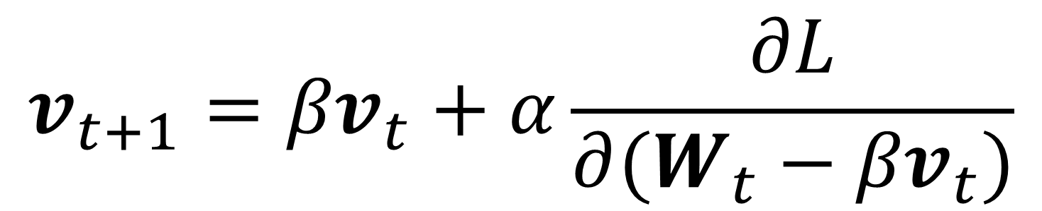
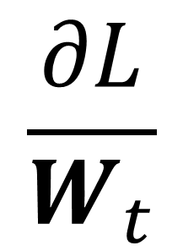
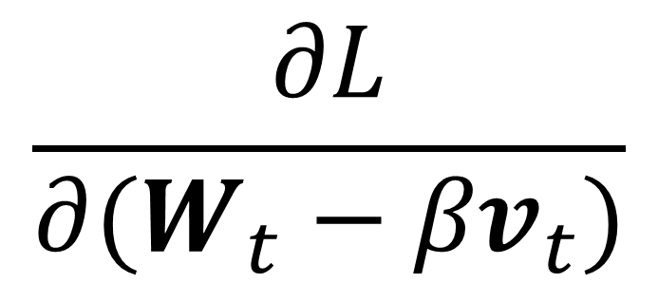
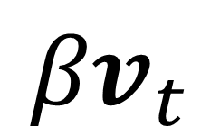
Nesterov momentum
GD with momentum
GD with Nesterov momentum
IDEA: Look forward to compute new gradient at $W_{t}−{βv}_{t}$
$$v_{t+1}={βv}_{t}+α\frac{∂L}{W_{t}}$$
$$v_{t+1}={βv}_{t}+α\frac{∂L}{{∂(W}_{t}−{βv}_{t})}$$
$$W_{t+1}=W_{t}−v_{t+1}$$
$$W_{t+1}=W_{t}−v_{t+1}$$
$$\frac{∂L}{{∂(W}_{t}−{βv}_{t})}$$
update vector
update vector for parameter
$${βv}_{t}$$
$${βv}_{t}$$
$$\frac{∂L}{W_{t}}$$
$$\frac{∂L}{W_{t}}$$
Nesterov, “A method of solving a convex programming problem with convergence rate O($\frac{1}{k^{2}}$)”, Dokl. akad. nauk Sssr 269, 543-547, 1983

Slide 7
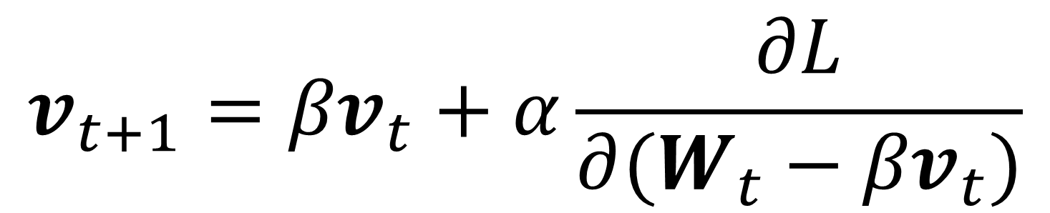
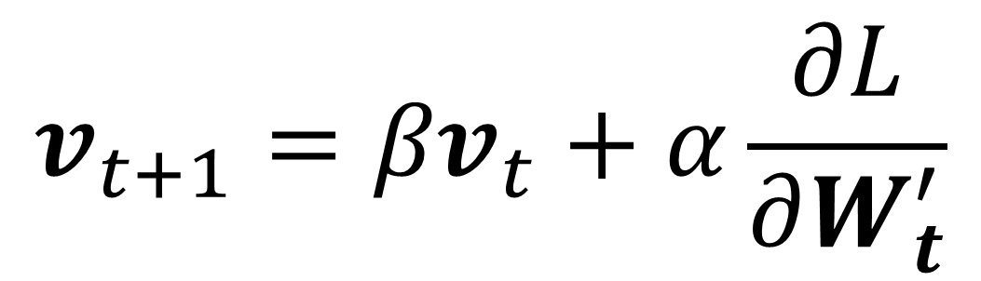
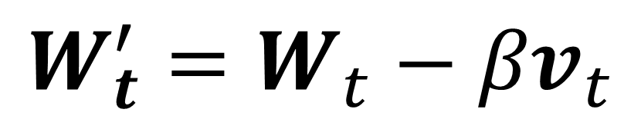
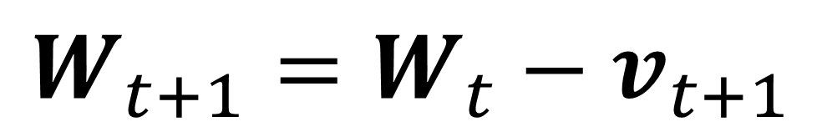
Nesterov momentum
$$v_{t+1}={βv}_{t}+α\frac{∂L}{{∂(W}_{t}−{βv}_{t})}$$
To avoid evaluation gradient at the look-forward location, we can reformat the equation:
$$W_{t+1}=W_{t}−v_{t+1}$$
GD with Nesterov momentum
$$W_{t}^{′}=W_{t}−{βv}_{t}$$
$$v_{t+1}={βv}_{t}+α\frac{∂L}{∂W_{t}^{′}}$$
$$W_{t+1}^{′}−{βv}_{t+1}=W_{t}^{′}−βv_{t}−v_{t+1}$$
$$W_{t+1}^{′}=W_{t}^{′}−(1−β) v_{t+1}−βv_{t}$$
Nesterov, “A method of solving a convex programming problem with convergence rate O($\frac{1}{k^{2}}$)”, Dokl. akad. nauk Sssr 269, 543-547, 1983

Slide 8
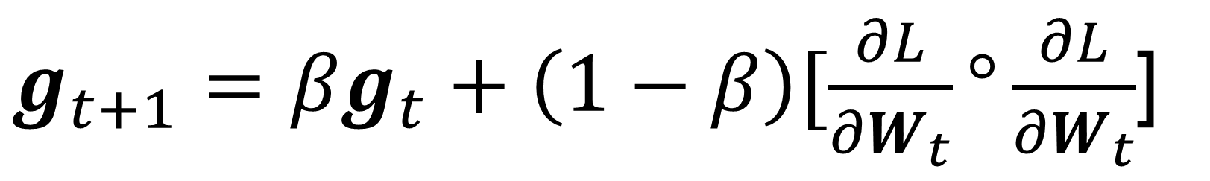
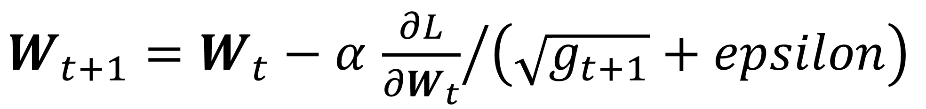
RMSProp : adaptive learning with gradient magnitude
$g_{t+1}={βg}_{t}+\left(1−β\right)[\frac{∂L}{{∂W}_{t}}°\frac{∂L}{{∂W}_{t}}$]
Smaller gradient : we may want to move faster along this direction
$W_{t+1}=W_{t}−α$ ${\frac{∂L}{{∂W}_{t}}}/{\left(\sqrt{g_{t+1}}+epsilon\right)}$
Element-wise multiplication and division
For large t, update gets smaller and smaller
Tend to got stuck in flat plain
Larger gradient: we may not want to move slower along this direction
lecture 6 of the online course “Neural Networks for Machine Learning”

Slide 9
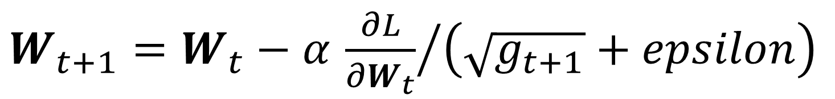
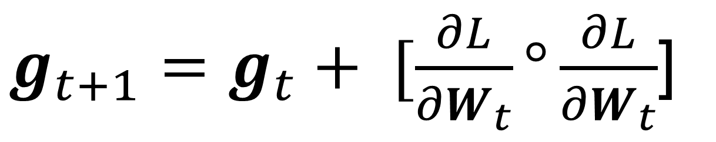
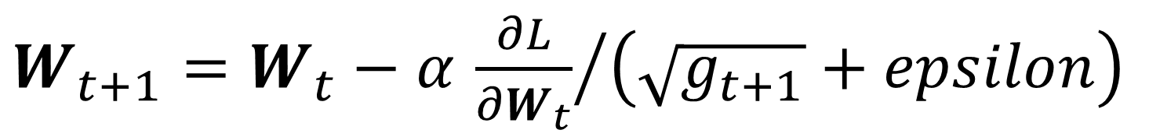
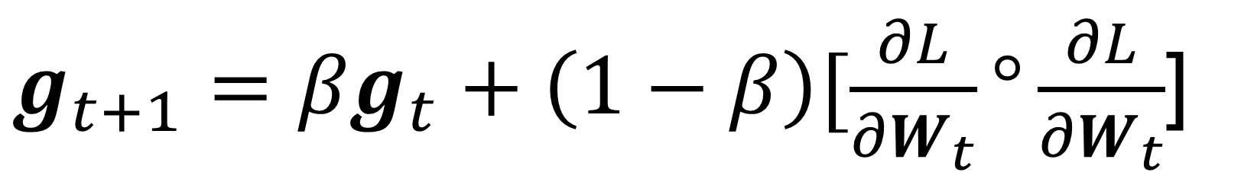
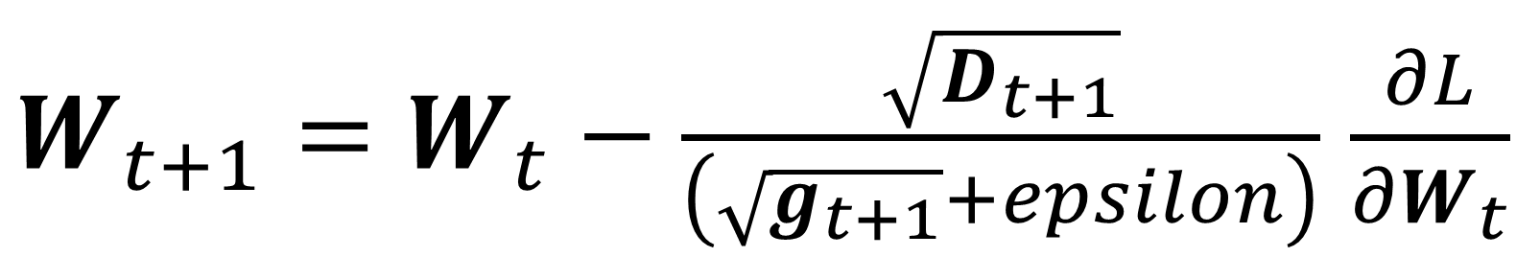
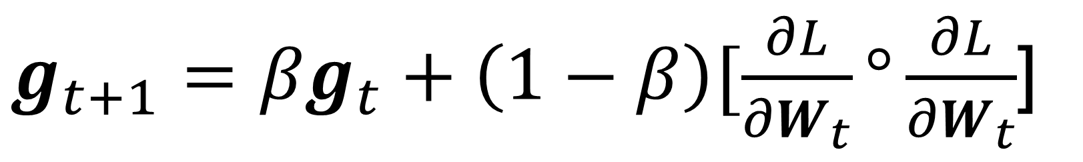
AdaGrad and AdaDelta : Other flavors
RMSprop
AdaGrad
AdaDelta
$g_{t+1}={βg}_{t}+\left(1−β\right)[\frac{∂L}{{∂W}_{t}}°\frac{∂L}{{∂W}_{t}}$]
$g_{t+1}=g_{t}+ [\frac{∂L}{{∂W}_{t}}°\frac{∂L}{{∂W}_{t}}$]
$g_{t+1}={βg}_{t}+\left(1−β\right)[\frac{∂L}{{∂W}_{t}}°\frac{∂L}{{∂W}_{t}}$]
$W_{t+1}=W_{t}−α$ ${\frac{∂L}{{∂W}_{t}}}/{\left(\sqrt{g_{t+1}}+epsilon\right)}$
$W_{t+1}=W_{t}−α$ ${\frac{∂L}{{∂W}_{t}}}/{\left(\sqrt{g_{t+1}}+epsilon\right)}$
$D_{t+1}={βD}_{t}+\left(1−β\right)[(W_{t}−W_{t−1})°(W_{t}−W_{t−1})$]
$W_{t+1}=W_{t}−\frac{\sqrt{D_{t+1}}}{\left(\sqrt{g_{t+1}}+epsilon\right)}$ $\frac{∂L}{{∂W}_{t}}$
Remove moving average
Use magnitude of gradient change to replace learning rate
https://arxiv.org/abs/1212.5701
lecture 6 of the online course “Neural Networks for Machine Learning”
https://jmlr.org/papers/v12/duchi11a.html

Slide 10

RMSProp : adaptive learning with gradient magnitude
SGD progresses slowly
Momentum and Nesterov Momentum took detour along large gradient direction
RMSprop avoids detour
https://imgur.com/a/Hqolp#NKsFHJb

Slide 11
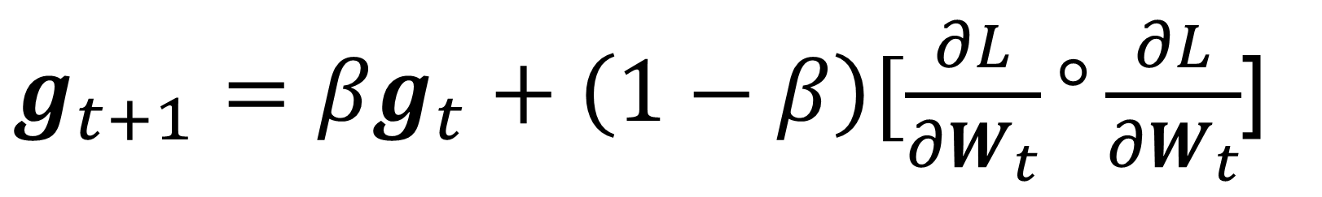
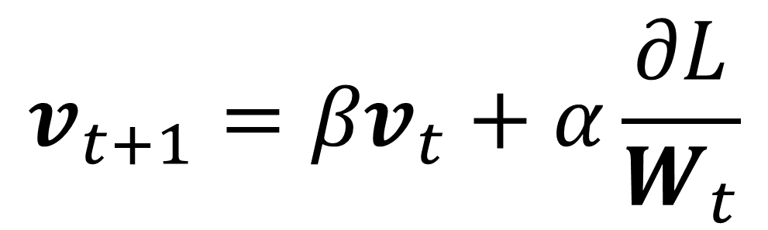
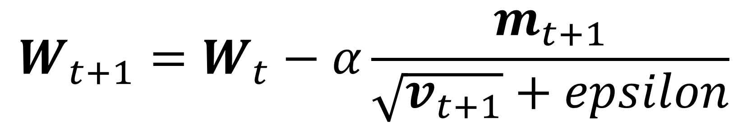
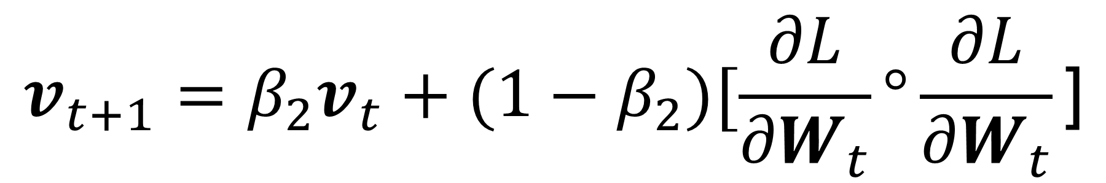
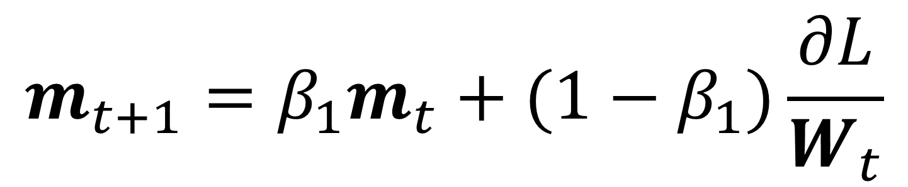
ADAM, adaptive moment estimation : best of two worlds
IDEA: Momentum with gradient magnitude adapted learning rate
$$v_{t+1}={βv}_{t}+α\frac{∂L}{W_{t}}$$
$g_{t+1}={βg}_{t}+\left(1−β\right)[\frac{∂L}{{∂W}_{t}}°\frac{∂L}{{∂W}_{t}}$]
$$m_{t+1}={β_{1}m}_{t}+(1−β_{1})\frac{∂L}{W_{t}}$$
Momentum
$$v_{t+1}={β_{2}v}_{t}+(1−β_{2})[\frac{∂L}{{∂W}_{t}}°\frac{∂L}{{∂W}_{t}}\text{]}$$
Gradient magnitude
$$W_{t+1}=W_{t}−α\frac{m_{t+1}}{\sqrt{v_{t+1}}+epsilon}$$
Updates weighted by gradient momentum scaled by element-wise gradient magnitude
Kingma and Ba, “Adam: A method for stochastic optimization”, ICLR 2015

Slide 12
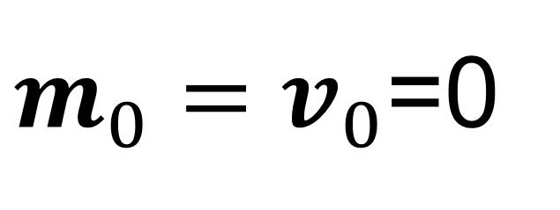
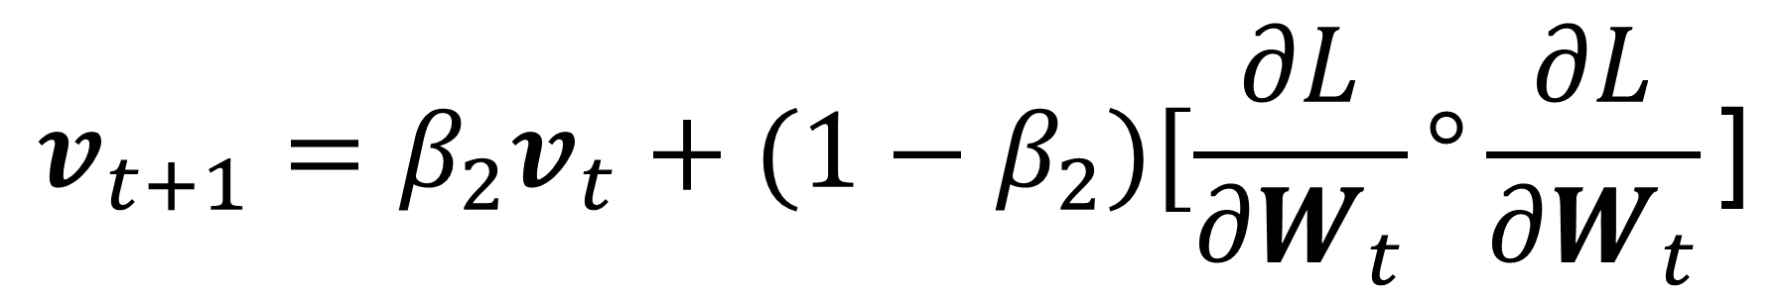
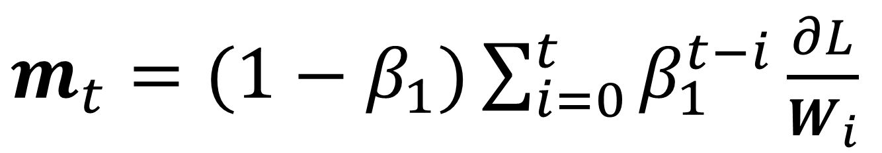
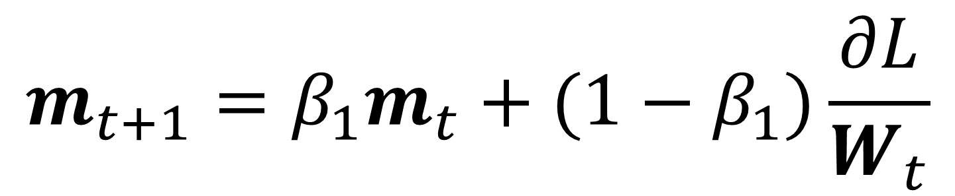
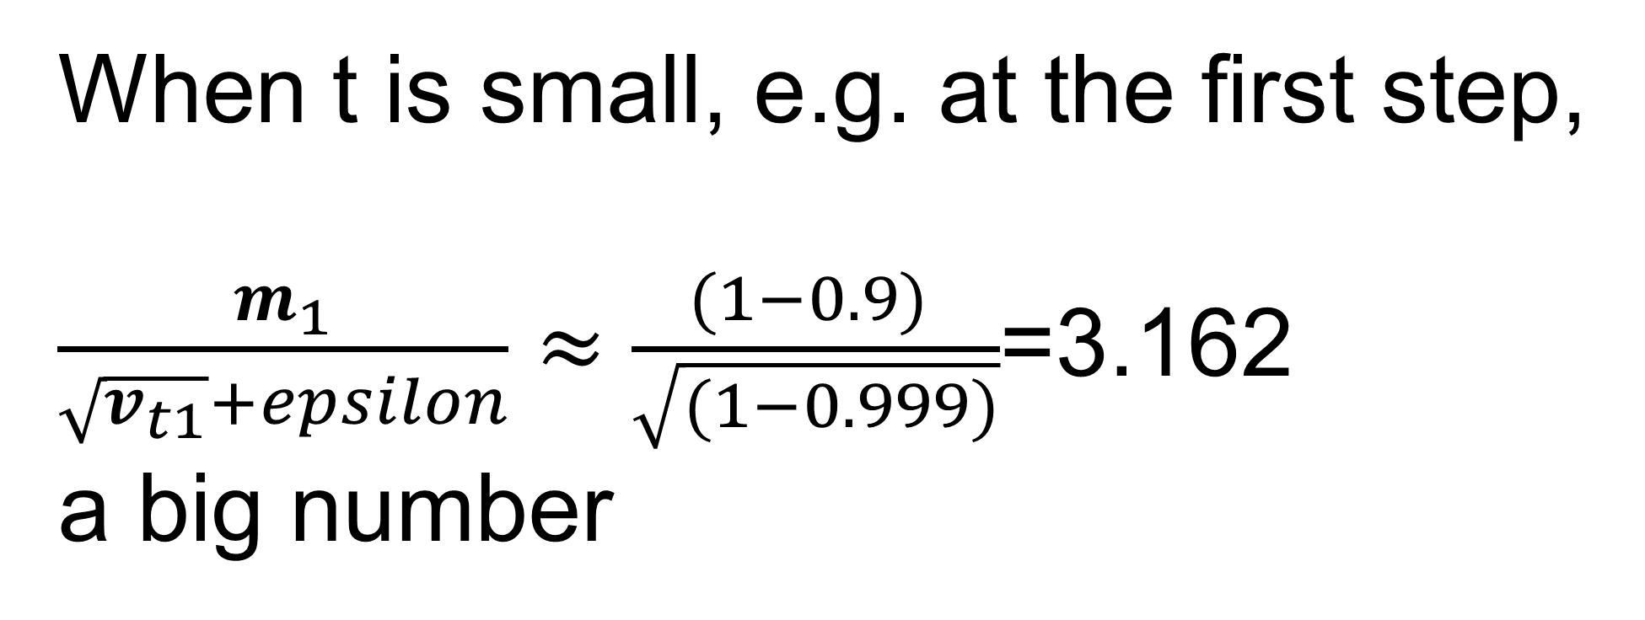

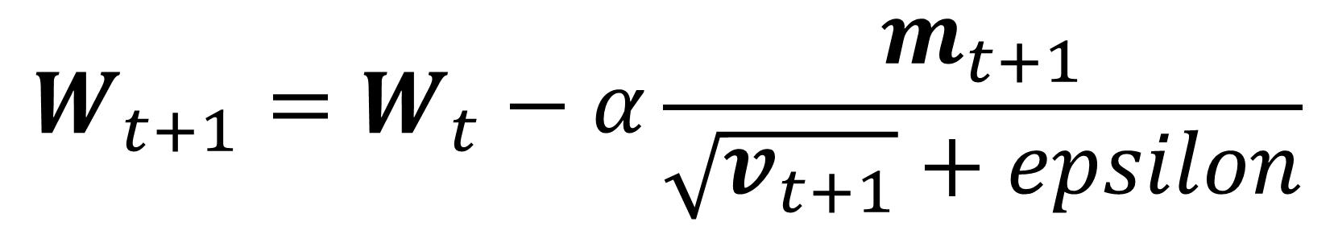
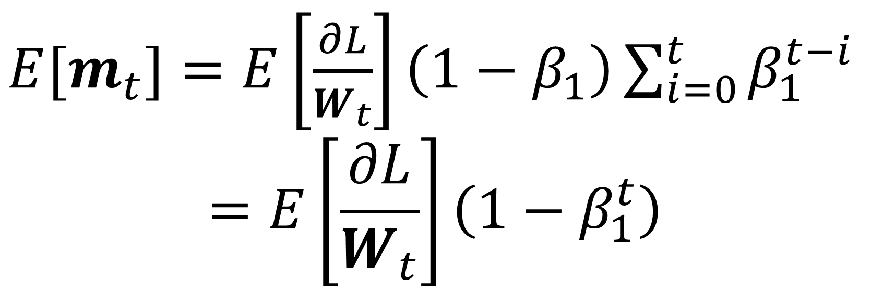
ADAM, adaptive moment estimation : best of two worlds
IDEA: Momentum with gradient magnitude adapted learning rate
When t is small, e.g. at the first step,
$\frac{m_{1}}{\sqrt{v_{t1}}+epsilon}≈\frac{(1−0.9) }{\sqrt{(1−0.999)}}$=3.162
a big number
$m_{0}=$ $v_{0}$=0
$$m_{t+1}={β_{1}m}_{t}+(1−β_{1})\frac{∂L}{W_{t}}$$
Momentum
$$v_{t+1}={β_{2}v}_{t}+(1−β_{2})[\frac{∂L}{{∂W}_{t}}°\frac{∂L}{{∂W}_{t}}\text{]}$$
Gradient magnitude
$m_{t}=$ $(1−β_{1})\sum_{i=0}^{t}{β_{1}^{t−i}}\frac{∂L}{W_{i}}$
$$W_{t+1}=W_{t}−α\frac{m_{t+1}}{\sqrt{v_{t+1}}+epsilon}$$
${E[m}_{t}]=$ $E\left[\frac{∂L}{W_{t}}\right]\left(1−β_{1}\right)\sum_{i=0}^{t}{β_{1}^{t−i}}$
$$=E\left[\frac{∂L}{W_{t}}\right]\left(1−β_{1}^{t}\right)$$
Updates weighted by inverse gradient magnitude
Often, $β_{1}=0.9, β_{2}$=0.999, $epsilon$=1e-7
Kingma and Ba, “Adam: A method for stochastic optimization”, ICLR 2015

Slide 13
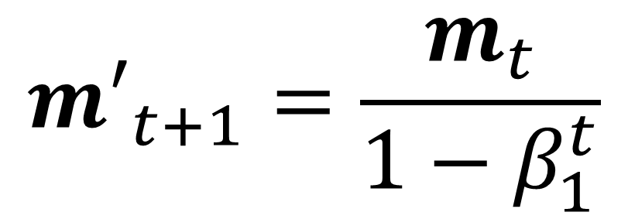
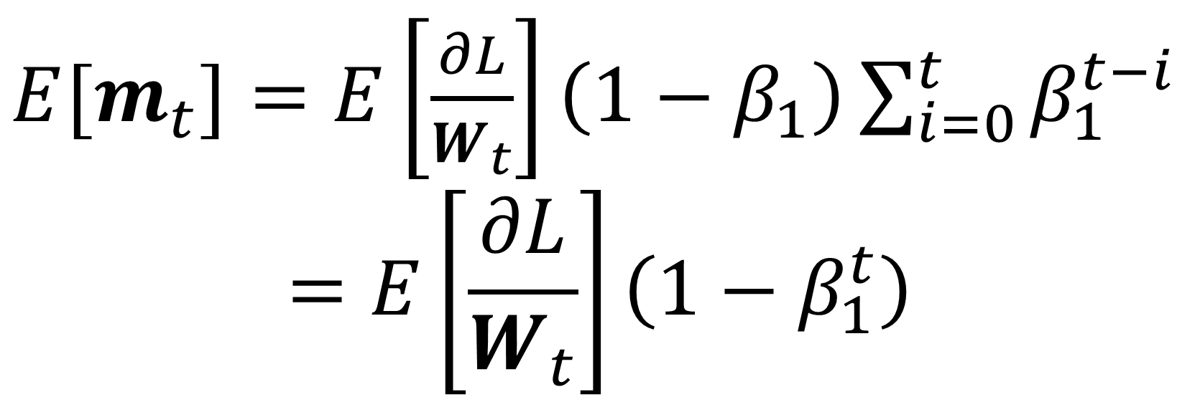

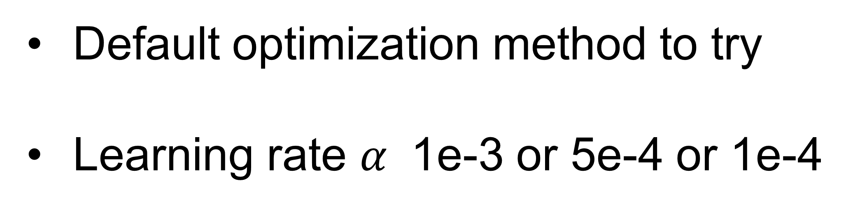
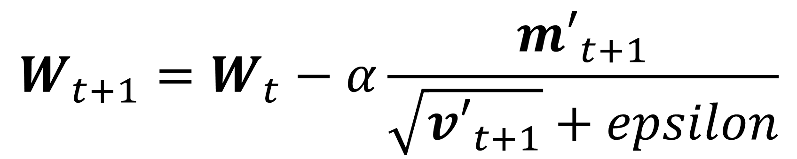
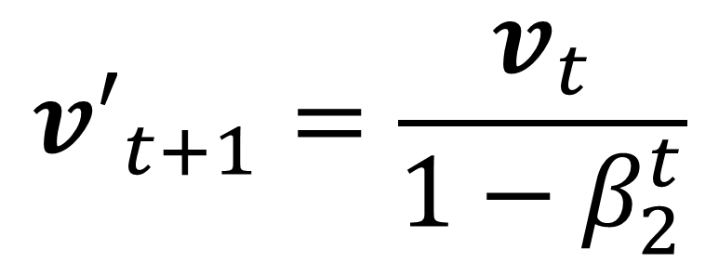
ADAM, adaptive moment estimation : best of two worlds
IDEA: Momentum with gradient magnitude adapted learning rate
${E[m}_{t}]=$ $E\left[\frac{∂L}{W_{t}}\right]\left(1−β_{1}\right)\sum_{i=0}^{t}{β_{1}^{t−i}}$
$$=E\left[\frac{∂L}{W_{t}}\right]\left(1−β_{1}^{t}\right)$$
$m_{0}=$ $v_{0}$=0
$$m_{t+1}={β_{1}m}_{t}+(1−β_{1})\frac{∂L}{W_{t}}$$
Momentum
$$v_{t+1}={β_{2}v}_{t}+(1−β_{2})[\frac{∂L}{{∂W}_{t}}°\frac{∂L}{{∂W}_{t}}\text{]}$$
Gradient magnitude
Default optimization method to try
Learning rate $α$ 1e-3 or 5e-4 or 1e-4
$${m′}_{t+1}=\frac{m_{t}}{1−β_{1}^{t}}$$
$${v′}_{t+1}=\frac{v_{t}}{1−β_{2}^{t}}$$
Bias correction
$$W_{t+1}=W_{t}−α\frac{{m′}_{t+1}}{\sqrt{{v′}_{t+1}}+epsilon}$$
Updates weighted by inverse gradient magnitude
Often, $β_{1}=0.9, β_{2}$=0.999, $epsilon$=1e-7
Kingma and Ba, “Adam: A method for stochastic optimization”, ICLR 2015

Slide 14
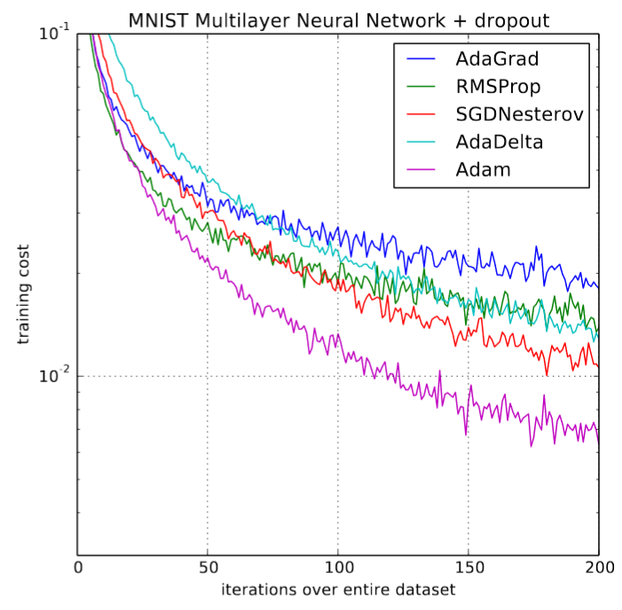
ADAM, adaptive moment estimation : best of two worlds
https://bl.ocks.org/EmilienDupont/aaf429be5705b219aaaf8d691e27ca87
Kingma and Ba, “Adam: A method for stochastic optimization”, ICLR 2015
https://www.fast.ai/2018/07/02/adam-weight-decay/

Slide 15
First-order methods : Use gradient information
Method | Pros | Cons
Gradient descent | Guarantee to converge to a local minima; global minima if convex loss function | Need to evaluate on entire training set
SGD, Mini-batch SGD | Fast for each iteration to evaluate a batch of samples | Harder to tune learning rate; larger the batch, higher the learning rate; noisy trajectory to convergence; can be stuck at saddle points
SGD Momentum | Use accumulated gradient to accelerate updates if gradient direction remains unchanged; to slow updates if gradient direction rapidly changes; help jump out local minima; less noisy convergence trajectory | Need to carefully choose learning rate
Nesterov SGD Momentum | Look forward to compute gradient after applying the momentum velocity; can help if momentum points to wrong direction | Need to tune learning rate
RMSProp | Moving averaged gradient magnitude; tune learning rate for each parameter with its accumulated historical magnitude | Slower convergence, compared to SGD, in general
AdaGrad | Accumulated gradient history, without moving averaging | With more iteration, updates get smaller
AdaDelta | Further replace learning rate by moving average of previous gradient updates | Smaller updates near local minima
Adam | “Best of two world”, having momentum and adaptive learning rate | Require some more hyperparameter tuning to achieve best convergence*
*https://www.fast.ai/2018/07/02/adam-weight-decay/

Slide 16
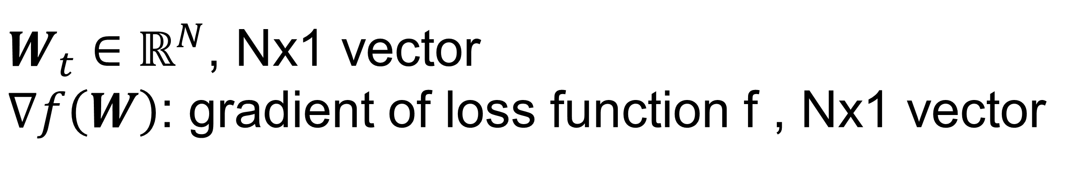
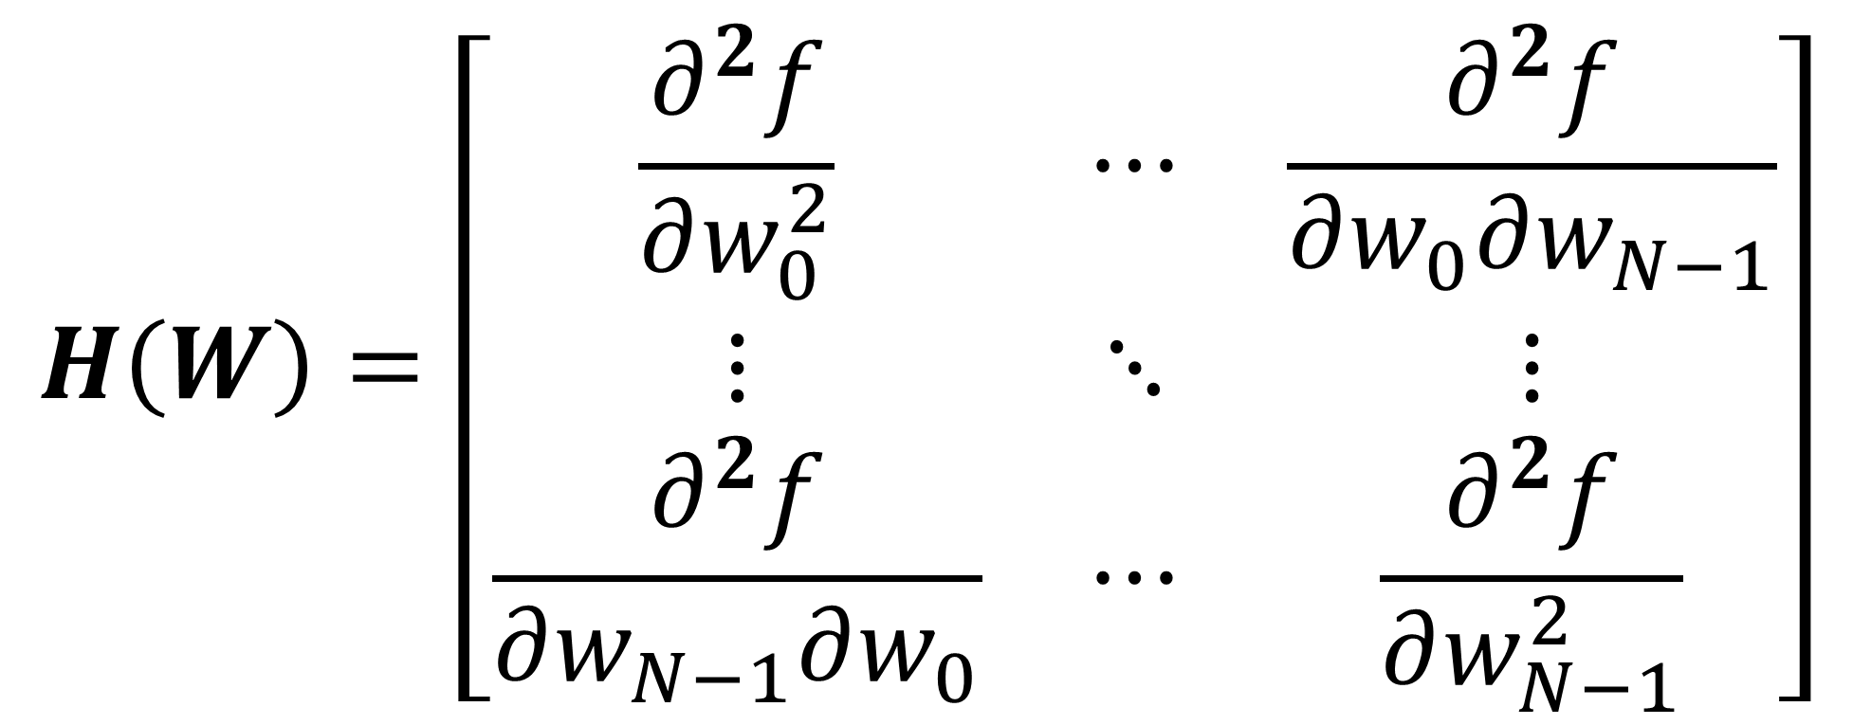
Second-order optimization : Newton method
IDEA: Use the Hessian matrix of the loss function
$$f\left(W_{t+1}\right)≈f\left(W_{t}\right)+∇^{T}f\left(W_{t}\right)\left(W_{t+1}−W_{t}\right)+\frac{1}{2}\left(W_{t+1}−W_{t}\right)H\left(W_{t}\right)\left(W_{t+1}−W_{t}\right)$$
$W_{t}∈ℝ^{N}$, Nx1 vector
$∇f\left(W\right)$: gradient of loss function f , Nx1 vector
$$H\left(W\right)=\left[\begin{matrix}\frac{∂^{2}f}{∂w_{0}^{2}} & ⋯ & \frac{∂^{2}f}{∂w_{0}∂w_{N−1}} \\ ⋮ & ⋱ & ⋮ \\ \frac{∂^{2}f}{∂w_{N−1}∂w_{0}} & ⋯ & \frac{∂^{2}f}{∂w_{N−1}^{2}}\end{matrix}\right]$$
Hessian matrix, 2nd order derivatives of loss f

Slide 17

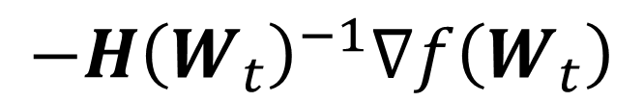
Second-order optimization : Newton method
IDEA: Use the Hessian matrix of the loss function
$$f\left(W_{t+1}\right)≈f\left(W_{t}\right)+∇^{T}f\left(W_{t}\right)\left(W_{t+1}−W_{t}\right)+\frac{1}{2}\left(W_{t+1}−W_{t}\right)H\left(W_{t}\right)\left(W_{t+1}−W_{t}\right)$$
We want to find what the next update $W_{t+1}$ is.
So take derivate to $W_{t+1}$ and set the derivative to zero:
$$0=∇f\left(W_{t}\right)+H\left(W_{t}\right)\left(W_{t+1}−W_{t}\right)$$
$$W_{t+1}=W_{t}−{H\left(W_{t}\right)}^{−1}∇f\left(W_{t}\right)$$
If we can compute the inverse of the hessian matrix, then we can get to the minima in one update.
For a quadratic function, find minimal in one step.
$$−{H\left(W_{t}\right)}^{−1}∇f\left(W_{t}\right)$$

Slide 18
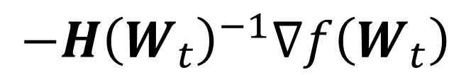
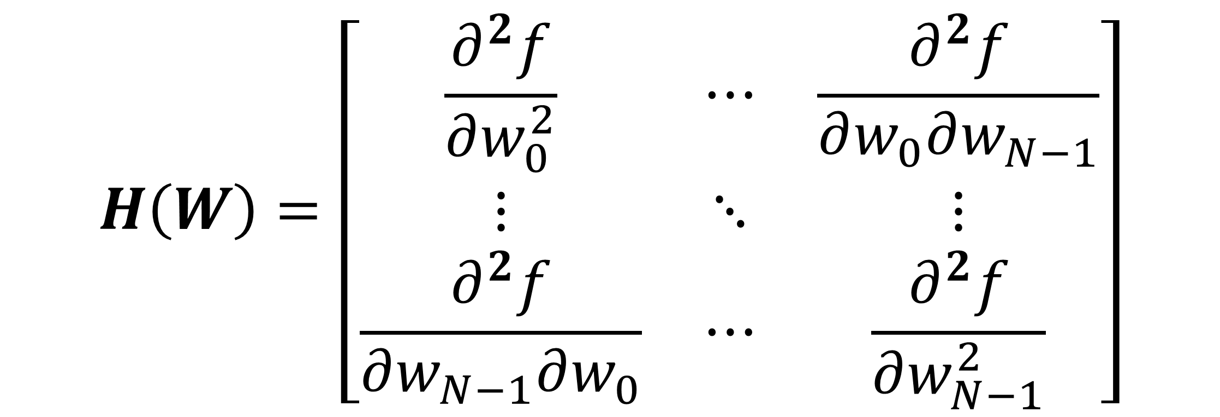
Second-order optimization : Newton method
Does not work for deep learning, due to large number of parameters
$$H\left(W\right)=\left[\begin{matrix}\frac{∂^{2}f}{∂w_{0}^{2}} & ⋯ & \frac{∂^{2}f}{∂w_{0}∂w_{N−1}} \\ ⋮ & ⋱ & ⋮ \\ \frac{∂^{2}f}{∂w_{N−1}∂w_{0}} & ⋯ & \frac{∂^{2}f}{∂w_{N−1}^{2}}\end{matrix}\right]$$
$$−{H\left(W_{t}\right)}^{−1}∇f\left(W_{t}\right)$$
Need to invert a NxN dense matrix

Slide 19


Second-order optimization : Quasi-Newton Method
IDEA: Approximate Hessian matrix from previous ${[W}_{t},∇f\left(W_{t}\right)$]
$$f\left(W_{t+1}\right)≈f\left(W_{t}\right)+∇^{T}f\left(W_{t}\right)\left(W_{t+1}−W_{t}\right)+\frac{1}{2}\left(W_{t+1}−W_{t}\right)H\left(W_{t}\right)\left(W_{t+1}−W_{t}\right)$$
We want to approximate the hessian matrix, take derivative to $W_{t+1}$:
$∇f\left(W_{t+1}\right)$ $≈∇f\left(W_{t}\right)$+ $H\left(W_{t}\right)\left(W_{t+1}−W_{t}\right)$
$H\left(W_{t}\right)$ $≈\frac{∇f\left(W_{t+1}\right)−∇f\left(W_{t}\right)}{W_{t+1}−W_{t}}$
Use first-order derivative to approximate the second order derivative, if N=1
Let $u_{t}=∇f\left(W_{t+1}\right)−∇f\left(W_{t}\right)$, $s_{t}=W_{t+1}−W_{t}$
Use $B_{t}=B\left(W_{t}\right)$ to approximate the hessian matrix
The quasi-Newton condition
The update of Quasi-Newton method is: $−{B\left(W_{t}\right)}^{−1}∇f\left(W_{t}\right)$

Slide 20


Second-order optimization : Quasi-Newton Method
Need linear search to find optimal learning rate for every iteration
$$W_{t+1}=W_{t}−{α_{t}B\left(W_{t}\right)}^{−1}∇f\left(W_{t}\right)$$
$$α_{t}=\min_{α_{t}}{f(W_{t}−{α_{t}B\left(W_{t}\right)}^{−1}∇f\left(W_{t}\right))}$$
Linear search is a 1D minimization to find the best step size along the search direction $−{B\left(W_{t}\right)}^{−1}∇f\left(W_{t}\right)$
Why we need the linear search?
Because we assumed a quadratic function to approximate loss function in the neighborhood around $W_{t}$

Slide 21


Second-order optimization : BFGS method
A popular way to compute $B\left(W_{t}\right)$ and its inverse is the BFGS (Broyden, Fletcher, Goldfarb and Shannon) equation :
$$B_{t+1}=B_{t}−\frac{B_{t}s_{t}s_{t}^{T}B_{t}}{s_{t}^{T}B_{t}s_{t}}+\frac{u_{t}u_{t}^{T}}{u_{t}^{T}s_{t}}$$
Let $u_{t}=∇f\left(W_{t+1}\right)−∇f\left(W_{t}\right)$, $s_{t}=W_{t+1}−W_{t}$
$$B_{t+1}^{−1}=\left(I−\frac{s_{t}u_{t}^{T}}{s_{t}^{T}u_{t}}\right)B_{t}^{−1}\left(I−\frac{u_{t}s_{t}^{T}}{s_{t}^{T}u_{t}}\right)+\frac{u_{t}s_{t}^{T}}{s_{t}^{T}u_{t}}$$
No need to explicitly compute matrix inversion
Approximation of inverse Hessian matrix is updated in each iteration
Still need to keep a NxN matrix in memory
R. Fletcher, “A new approach to variable metric algorithms,” The Computer Journal, vol. 13, pp. 317–322, 1970.
D. Goldfarb, “A family of variable-metric methods derived by variational means,” Mathematics of Computation, vol. 24, pp. 23–26, 1970.

Slide 22

Second-order optimization : L-BFGS method
Instead of keeping a NxN matrix in memory, compute it with a set of $\left[u_{k}, s_{k}\right], k=t, t−1, …, t−p$
We save current vector pair $\left[u_{t}, s_{t}\right]$ and its history for past p steps
L-BFGS update requires to compute $u_{t}=∇f\left(W_{t+1}\right)−∇f\left(W_{t}\right)$
Batch L-BFGS uses all training samples to stabilize $u_{t}$
Mini-Batch L-BFGS computes $u_{t}=∇_{samples of batch t+1}f\left(W_{t+1}\right)−∇_{samples of batch t}f\left(W_{t}\right)$
This is still active research, but one way to make L-BFGS work with mini-batch updates is:
${Batch}_{t+1}∩$ ${Batch}_{t}≠∅$
A. S. Berahas, J. Nocedal, and M. Tak´ac, “A multi-batch L-BFGS method for machine learning,” in Advances in Neural Information Processing Systems, 2016, pp. 1055–1063.
https://pytorch.org/docs/stable/generated/torch.optim.LBFGS.html

Slide 23

Learning rate is the most important hyper-parameter
https://www.jeremyjordan.me/nn-learning-rate/

Slide 24

Learning rate is the most important hyper-parameter
Landscape of loss function, projected to 2D
Resnet 56 without skip connection
There are many local minima
Visualizing the Loss Landscape of Neural Nets. https://arxiv.org/pdf/1712.09913.pdf

Slide 25

Learning rate finding
Gradually increase the learning rate after each mini batch
Cyclical Learning Rates for Training Neural Networks. https://arxiv.org/abs/1506.01186

Slide 26
Find a good learning rate
Initialize model
loss = []
for batch in TrainingSet:
Evaluate loss function (forward pass) at this batch
loss.append(curr_loss)
Compute gradient
Update parameter
ReInitialize model
Select a good learning rate from loss buffer
Start main training loop with selected learning rate
A good point with steep loss reduction and far from “unstable zone”
Unstable, not a good LR
Cyclical Learning Rates for Training Neural Networks. https://arxiv.org/abs/1506.01186

Slide 27
Learning rate annealing
Travel through the loss landscape fast at the beginning and try to land into a good local minima with reduced learning rate
Start with high learning rate
Gradually reduce learning rate for larger epochs

Slide 28





Learning rate annealing
Different ways to decay the learning rate
Step LR
Exponential LR
Cycle LR
Regularly increasing learning rate to encourage exploration
Guide to Pytorch Learning Rate Scheduling. https://www.kaggle.com/isbhargav/guide-to-pytorch-learning-rate-scheduling/notebook

Slide 29


Learning rate annealing
One-cycle learning rate policy is a good approach.
OneCycleLR - cos
OneCycleLR - linear
High LR for exploration
LR
LR decay to land into good minima
Lower LR for warm start
Low LR to squeeze final performance
epochs
Super-Convergence: Very Fast Training of Neural Networks Using Large Learning Rates. https://arxiv.org/abs/1708.07120

Slide 30

OneCycle LR
One-cycle learning rate policy can reach convergence faster with better accuracy.
Land into a good minima
High LR for exploration
Super-Convergence: Very Fast Training of Neural Networks Using Large Learning Rates. https://arxiv.org/abs/1708.07120

Slide 31


Hyperparameter
Type | Hyperparameters
Enumeration | Network architecture, Optimization method, LR scheduler, …
Float | learning rate, momentum, $β_{1 }and β_{2}$ in ADAM, L2 regularization strength …
Integer | Number of layers, number of neurons, batch size …

Slide 32

Hyperparameter tuning may matter
Hyperparameter sweeping using W&B

Slide 33

Grid search and random search
Use log scale for learning rate
lr = np.power(10, np.random.uniform(-6, -1))
Combine random search and grid search
More samples for more important hyperparameter
Easy to parallelize

Slide 34
Corse-to-fine search
Often half the search range and double the grid density
Easy to parallelize
Need to select more than one candidate configuration

Slide 35


Successive elimination
Give a total number of computing resource B, e.g. total number of epochs we can run
Give a set of initial hyperparameter configurations
# successive elimination
for k in range (N):
C = create_initial_configurations(k)
n = number_of_configuration(C)
while n>1:
Run all configurations in C for B/#C epochs
Sort these runs with validation loss/accuracy
Eliminate the bottom $η$ configurations from C
n = number_of_configuration(C)
save the best configuration
Pick the one configuration for all N trials
figure credit: https://blog.ml.cmu.edu/2018/12/12/massively-parallel-hyperparameter-optimization/
B = 27 epochs
Run 1: 27 configurations, 1 epoch each
Run 2: 9 configurations, 3 epoch each
Run 3: 3 configurations, 9 epoch each
Run 4: 1 configuration, 27 epoch each

Slide 36

Sometimes we can risk to loss good candidate configuration
It is very likely sometimes we need to run models with enough epochs to know how good this configuration is …
https://arxiv.org/pdf/1603.06560.pdf

Slide 37
Hyper-band : successive elimination with searching over n, given total resource
# hyperband
Given total amount of resource B
Given the minimal epoch to run r
N = max(n) subject to B and r
for n in range (start=N, stop=2, step=-1):
epoch_to_run = B/n
C = create_initial_configurations(n)
Successive elimination on C
save the best configuration
Pick the one configuration for all N trials
n: number of configurations
Start with maximal possible number of configurations and minimal possible number of epoch to run
Reduce number of tested configuration and increase epoch to run
Still need to repeat hyperband search
Hyperband: A Novel Bandit-Based Approach to Hyperparameter Optimization. https://arxiv.org/pdf/1603.06560.pdf

Slide 38


Hyper-band : successive elimination with searching over n, given total resource
First trial
Last trial
Total number of epochs: 5x81=405
Strategy 1: keep the total epochs running in a trial to be <B
Strategy 2: allow the total epochs running in a trial to over B
Hyperband: A Novel Bandit-Based Approach to Hyperparameter Optimization. https://arxiv.org/pdf/1603.06560.pdf

Slide 39


Bayesian hyperparameter optimization
Grid or random search treats every configuration independently
Hyperband searches allocated resource in the retrospective manner
Bayesian methods try to build a probability model of loss/accuracy over hyperparameters:
$$f\left(y, c\right)=P(y|c)$$
c is a hyperparameter configuration and y is the accuracy. Function f is the probability of y given c.
If we have a model f, we can estimate next best hyperparameter by maximizing the expected improvement:
$$EI\left(c\right)=\int_{0}^{1}{\left(1−y\right)P(y|c) dy}$$
For all possible accuracy and possible improvement (1-y), what is the expected improvement in accuracy?
The next hyperparameter selection is:
$$c^{∗}=\max_{c}{EI\left(c\right)}$$

Slide 40

Bayesian hyperparameter optimization
Bayesian methods interleave finding next best hyperparameter configuration and updating the probability model:
Initialize the probability model $f\left(y, c\right)=P(y|c)$
Set the maximal number of hyperparameter configurations to try as N
for n in range (N):
Select next best configuration:
$c^{∗}=\max_{c}{EI\left(c\right)}$
Train with $c^{∗}$ and compute accuracy $y^{∗}$
Update the probability model with $(c^{∗},y^{∗})$
Pick the one configuration with best accuracy
Different methods* used different tools to model probability – Parzen Window, Random forest …
Essentially sequential searching
Can be mitigated by training multiple configurations in parallel and update model in a faster pace
*https://papers.nips.cc/paper/2011/file/86e8f7ab32cfd12577bc2619bc635690-Paper.pdf

Slide 41




Implementation can be complicated
Implement these algorithms can become complicated for heterogeneous computing environment
Single user, single computer vs. multiple users, a cluster with CPU and GPUs
There are great tools for local setup and online services:
RayTune
Optuna

Slide 42

Set up training with Bias, variance, hyperparameter tuning in mind
Given a data set, model error is:
$E_{D}\left[{\left(y−M\left(x;D\right)\right)}^{2}\right]={\{E_{D}\left[M\left(x;D\right)\right]−f\left(x\right)\}}^{2}+$ $E_{D}\left[{(E_{D}\left(M\left(x;D\right)\right)−M\left(x;D\right))}^{2}\right]+σ^{2}$
Bias²
Variance
Bayes error

Slide 43
Estimate Bias and variance
We estimate Bias by comparing model performance with Bayes accuracy (suppose we have this information)
We estimate Variance by comparing model performance on training set and test set
Test error
error
Variance
Bias
Bayes error
Training error
Training data size

Slide 44

Can we tune hyper parameter on test set?
Bad idea!
Test set is used to get an unbiased estimation of model on real-world dataset
Tuning hyperparameters on test set leads to overfitting on test set
The model performance estimation will be overestimated

Slide 45
Train, Dev and Test
Train
Dev
Test
Train | Dev/Val | Test
Used to train the mode Used to estimate Bias | Used to tune the hyperparameter Used to estimate variance by comparing to the training error/accuracy Also called validation set | Used to get an unbiased estimation for model performance Not used in any way in training

Slide 46
Use Train, Dev and Test sets
Bayes accuracy
Bias
Need to have some information about Bayes accuracy
Bias from Bayes - Training
Variance from Train – Dev
Dev performance should be higher than Test set – overfitting to Dev set is possible
Training accuracy
Variance
Dev accuracy
Overfit to dev set
Test accuracy
accuracy
epoch

Slide 47

Use Train, Dev and Test sets
For human reader, we can expect a ~100% accuracy
Human level performance (HLP) as a surrogate to Bayes accuracy
 | Case 1 | Case 2 | Case 3 | Case 4
Training accuracy | 85% | 97% | 85% | 97%
Dev accuracy | 83% | 75% | 75% | 94%
Test accuracy | 82% | 74% | 73% | 85%
Dev overfitting
Bias
Variance
Both

Slide 48
Remedies
Diagnosis | Remedies
Bias | Increase model complexity Reduce regularization Train longer Conduct error analysis Hyperparameter searching

Slide 49
Remedies
Diagnosis | Remedies
Variance | Add more data Data synthesis Increase regularization Use BatchNorm, use drop out Data augmentation Early stopping Reduce model complexity

Slide 50
Remedies
Diagnosis | Remedies
Both | Iterate remedies for bias and variance
Dev overfitting | Add more dev data

Slide 51
Train, Dev and Test Split
Train
Dev
Test
The more data, the better
For small to medium datasets (a few hundred to a thousand samples), 70-30 split for train and dev
For large datasets (a few thousand or over), keep enough samples in Dev set to detect expected performance change in algorithms
if the probability of targeted events to happen is 10%
if we need at least a difference of 10 events to be sure
For test set, keep enough samples to make enough events happen
2x10/0.1= 200

Slide 52

Cross-validation
If the total amount of samples are small:
Less used in deep learning
If unbiased performance estimation is not a must-have, put all data to train and dev
Need to train multiple times
Figure credit: https://www.kaggle.com/discussion/204878

